Slide 1




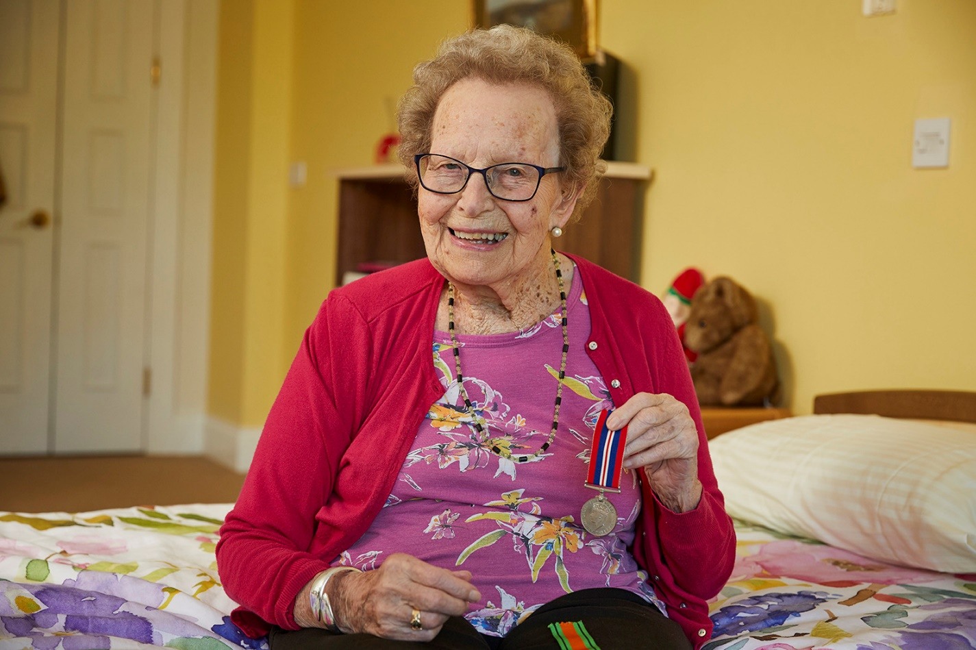
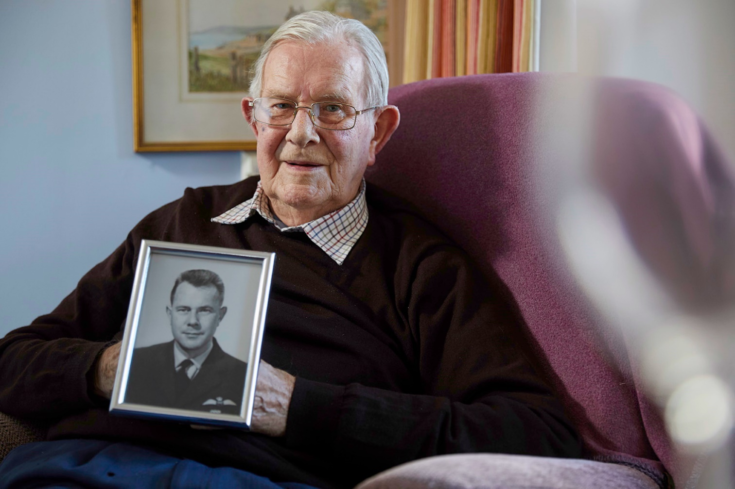
Veteran Friendly Framework - Project Support Officer
Candidate information pack

Slide 2
Introduction
Thank you for your interest in this new role, which will help support the roll out of our Veteran Friendly Framework designed to support veterans and their partners living in care homes across England.
Of the 15,000 care homes in the country, fewer than 20 offer specific support to those who have served in the UK Armed Forces. Most veterans live in ‘civilian’ care homes, that may not fully appreciate the social, emotional, or physical needs of veterans and their partners.
We know that military service is a key element of a person’s history; it shapes their views, affects their families, and particularly impacts on their physical and mental health. We estimate there are over 25,000 veterans living in residential social care. With the introduction in 2012 of The Armed Forces Covenant, now enshrined by law in the Armed Forces Bill, all NHS providers and local authorities must meet the requirements of this legislation. The Veteran Friendly Framework supports care homes in doing this.
We are looking for an experienced Project Support Officer to support the delivery of this project, working with care providers and national associations, local government, and the NHS. You will be part of a dynamic team developing a sustainable national programme that will deliver for veterans and their partners over the long term.
If this is you, then I very much look forward to receiving your application.
Kathryn Glass
Veteran friendly Framework Programme Lead
The role at a glance
Title: Veteran Friendly Framework Project Support Officer
Reports to: VFF Programme Lead
Salary: £28,000
Location: Remote working, ideally based in southern England, with expectations for some travel
Contract: 1-year fixed term
Employer: Royal Star & Garter
More information: vff@starandgarter.org

Slide 3
Job description
Royal Star & Garter (RSG) is working in partnership with Royal British Legion (RBL) and the Veterans Covenant Healthcare Alliance (VCHA) to deliver a Veteran Friendly Framework (VFF) for residential care and nursing homes across England. With over 25,000 veterans and their partners living in care homes that do not have a military focus, there is huge potential to use the VFF to make a difference to their wellbeing, social connections, and quality of life.
You will support care home providers nationally in delivering best practice in support of veterans and their partners to ensure that those who have served in the Armed Forces, whether regular or reserves can access appropriate services.
Deliver on the VFF project plan and milestones and report regularly against agreed performance indicators and targets
Ensuring a high standard of work supporting the delivery of the programme to time, to appropriate quality standards, and in a cost-effective manner.
Identify and contact care homes and groups of care providers to engage with the VFF programme
Maintain the programme’s contact databases; and act as a contact point for enquiring and accredited organisations, providing guidance, support and training as required.
Identify best practice to be shared across the programme.
Coordinate the delivery of Armed Forces awareness across care homes, including coordinating speakers, presentations etc. for events if required.
Work with stakeholders and build rapport with local/regional statutory services for the Armed Forces community.
Support the Programme Lead on the overall delivery and evaluation of the programme, including attending meetings and taking minutes/notes as needed.
Any other reasonable management requests.
To apply
Send your CV and a covering statement of no more than two sides explaining your interest in the role and how you meet the person specification to: ajla.Dizdarevic@starandgarter.org
Purpose
Key responsibilities

Slide 4
Job description - continued
Key relationships
VFF Project Lead
Local authorities
Care home staff/management teams
Local/regional statutory services for the Armed Forces community
Any other support services identified during the programme delivery
Marketing & Communications team at Royal Star & Garter
Working pattern
Full-time (35 hours per week, ability to compress over 4.5 days). This role will be home based but will require flexible working in terms of location and pattern. Occasional evening and weekend work will be required.
We are a values-based organisation and strive to demonstrate our values in all we do:
With love: We carry out our work with love, care and compassion
Living positively: We are optimistic in everything we do supporting veterans & their partners in leading happy and fulfilled lives
As a family: We work and live as one team, one family, one community
Standing in their shoes: We show admiration and respect for people and never forget what they have done
Care with courage: We are not afraid to do what is right and what is needed
Key responsibilities
Key relationships, working patterns & values

Slide 5
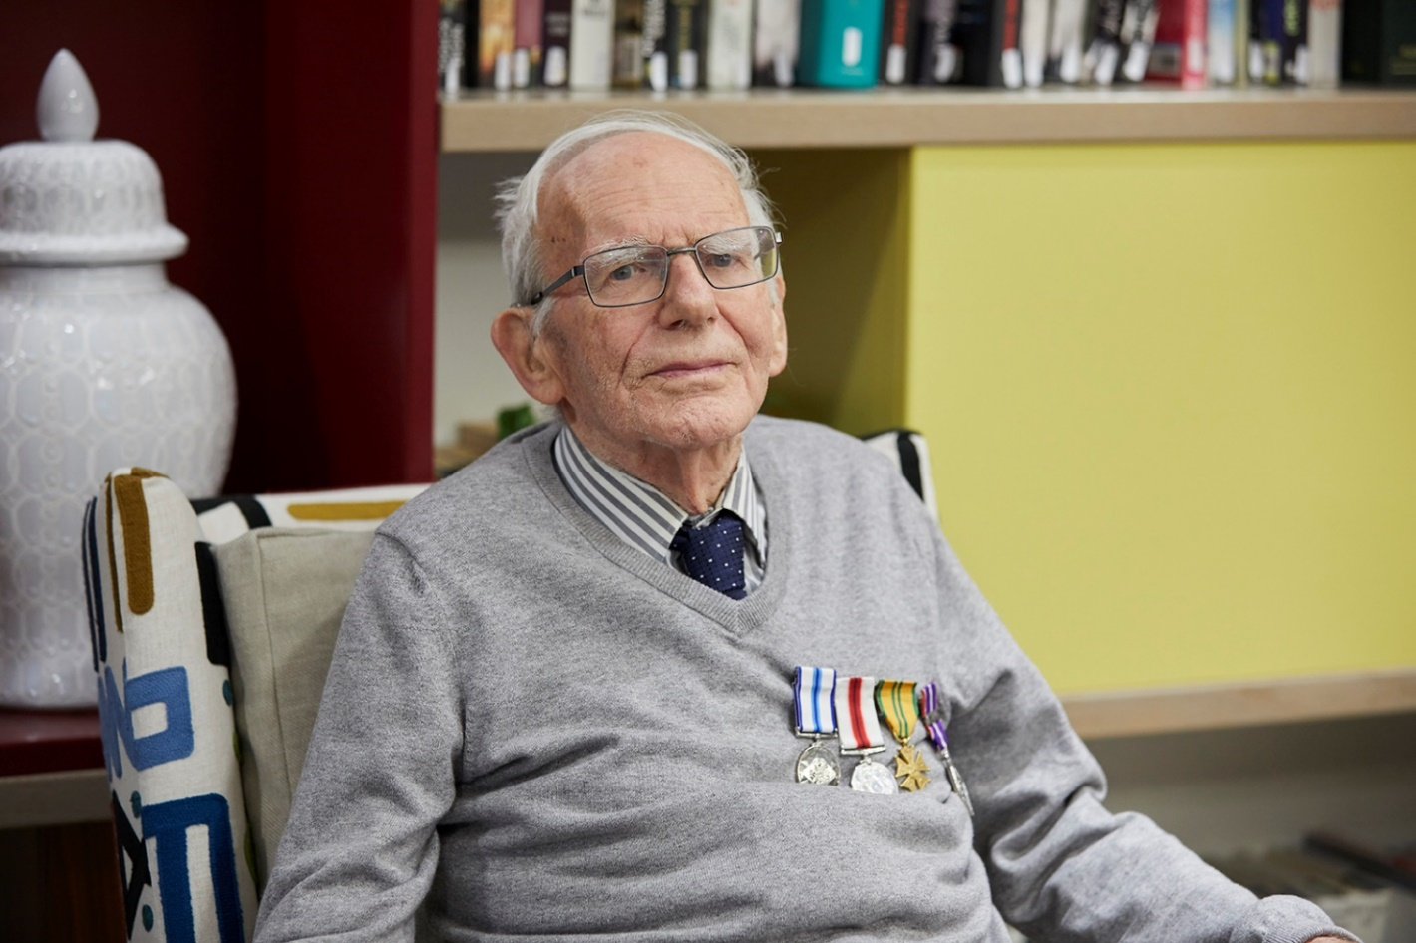
Person specification
Essential skills and experience
Excellent interpersonal and customer-facing skills.
Excellent communication skills with all levels of a workforce.
Excellent IT skills including use of MS 365 and Teams/Zoom to facilitate online meetings
Able to self-motivate, to motivate other and to manage own workload effectively.
Ability to travel independently as part of the national programme scope.
Desirable skills and experience
Experiences of working in social care and being in a public facing role
Understanding of and/or connections to Armed Forces community.
Understanding of charity sector.
Behaviours and characteristics
Flexible, able to work independently and a patient “can-do” approach
Able to use own initiative effectively for the best outcome of the programme
Committed to our mission, values and to enabling outstanding care for veterans

Slide 6
Conditions of employment
Any offer of employment made will be subject to the following conditions:
Satisfactory references covering the last 5 years including one from your current or most recent employer
A pre-employment medical screening
Enhanced DBS Disclosure
Proof of the Right to Work in the UK

Slide 7
Offer
We offer a generous package
Employer Pension Contribution of 7.5% with matching Employee contribution of 5%
Life insurance of 3 x salary (until age 70)
2 months full occupational sick pay, 1 month half pay before statutory sick pay
Salary of £28,000 per annum.
Full-time (35 hours per week).
Equivalent of 25 days holiday per annum plus bank holidays

